Slide 1
Probability Distributions

Slide 2

A Familiar Probability Distribution

Slide 3
Probability Distributions for Discrete and Continuous Variables
Probability – the proportion of times a particular outcome would be obtained over many observations; the relative frequency of an outcome
Probability is inherently a measure of uncertainty
We use the idea of probability whenever we say, “what are the chances of...”, or “how likely is it that...”
Probability distribution – the possible outcomes of a variable and their respective probabilities
The relative frequency for a particular value of x to fall in the interval (x, x+dx] is f(x, x+dx)/n

Slide 4
Axioms of Probability
Probabilities are always bound on
0 <= P(A) <=1
P(A) = 1 means A always occurs
P(A) = 0 means A never occurs
We can think of the probability of different kinds of events occurring
P(A), P(B), …
Where A and B are mutually exclusive events
Mutually exclusive meaning that only A or B can occur in a single outcome event, both cannot occur at once

Slide 5
Axioms of Probability
The probability of either A or B occurring is
P(A) + P(B)
The probability of both A and B occurring is
P(A) * P(B)
Rule of thumb: And = Multiply, Or = Add
The complement of P(A) is 1-P(A)
the probability A does not occur
P(A)+(1-P(A)) = 1

Slide 6
The Venn Diagram
Classical visual interpretation of probabilities
P(A) = .5, P(B) = .2, P(A ∩ B) = 0.10
The ∩ operator means take the intersection of A and
B, and is the probability of both A and B occurring
The Union of A and B is the probability that either A
or B occurs, but not both and is given by:
P(A U B) - P(A ∩ B) = P(A) + P(B) – P(A ∩ B) =
0.5 + 0.2 – 0.10 = 0.60
A
0.45
B
0.15
0.10

Slide 7
Conditional Probability
In classic probability, we have no information except the frequency of the event of interest.
Suppose we know that the probability is affected by another condition that we can observe, this is the notion of conditional probability.
We can write this as :
P(A|B), and say: the probability of A occurring, given B has occurred.
P(A|B) = P(A⋂B) / P(B)

Slide 8
The case of a 2 by 2 table
Here are some data on 1st and 2nd births, where we look at the probabilities of having a male or female child for women of parity 2 (have had a 2nd birth)
Pr(B2=M) =70/160 = .4375
Pr(B1=M)=85/160 = .5313
Pr(B2=M|B1=M) =15/85 =0.1765
Pr(B2=F|B1=M) = 70/85 =0.8235
 | 2nd Birth – Male | 2nd Birth – Female | Total
1st Birth – Male | 15 | 70 | 85
1st Birth – Female | 55 | 20 | 75
Total | 70 | 90 | 160

Slide 9
Probability Distribution for a Discrete Variable
For variable Y, each probability P(y) ranges between 0 and 1 and the sum of the probabilities is 1.

Slide 10




Probability Distribution for a Discrete Variable
For a discrete random variable, the probability distribution for that variable shows the probability of getting each of the distinct levels of that variable.
The probability of observing a value of x at a particular value of x is :
f(x) = P(x=X), f(x) >= 0 and Σf(x) = 1
e.g. For the data on first births in the US in 2006
There were 870,799 Male and 826,190 Female first births. The probability plot for this would look like:

Slide 11
Probability Distribution for a Discrete Variable
We can likewise examine the distribution of births by birth order in 2006, which follows a discrete distribution
You can only be a 1st or a 2nd or a 3rd… order birth

Slide 12

Binomial Distribution
The Binomial has population mean:
$$nπ$$
Where $π$ is the probability of success
The Binomial has a population standard deviation:
$$nπ(1 −π)$$

Slide 13

Binomial Distribution
Generates a discrete random variables that consist of:
$n$ random trials
Each of the n trials can have one of two possible outcomes (yes/no, 1/0, on/off)
The probability of success at each particular trial is denoted, $π$, and is the same for each trial
Think of flipping a coin, .5 chance=Heads, .5 chance=tails
Each trial is independent of one another
The coin doesn't remember the last flip
The random variable, y, is the number of successes observed during the n trials.

Slide 14

Binomial Distribution
Application of the binomial to my PhD Cohort
How like the rest of UTSA was my cohort given that 25% of PhD students are international. There were 3 international students out of 9 total
To calculate the probability of this level of foreign students, we use the binomial probability function:
$$P\left(y\right)= \frac{n!}{y!\left(n−y\right)!}π^{y} {(1−π)}^{n−y}$$
Where n is the number of trials, y is the number of successes, π is the probability of a success at every trial, and ! is the symbol for factorial, e.g. 3! = 3*2*1 in our example, we have n=9 trials (the number of students in our class), and y=3 (3 international students). π=.25, the % of foreign PhD students at UTSA We have a probability of seeing such a class as mine of 0.233, if we use the UTSA proportion as a guide, my cohort was not too different

Slide 15

Poisson Distribution
Another distribution commonly used for counts of observations is the Poisson
It is commonly used to model counts of events that occur in discrete periods of time or space
# of H1N1 cases within Bexar county between April and May 2009
# of children a couple has between 1990 and 2000
The assumptions of the Poisson distribution are:
Events occur 1 at a time (and not at the exact same time/place/to the same person)
Each occurrence at a given time or place is independent
The expected number of events, μ, at any time or place is the same at all times/places
$$P\left(y\right)= \frac{μ^{y}e^{−μ}}{y!}$$

Slide 16

Probability Distribution for Continuous Variable
Compared to the discrete distributions, continuous distributions are defined for (theoretically) an infinite variety of values along the number line, both positive or negative, or just positive (for some distributions).
In continuous form, the probability of observing an occurrence of X at a particular value of x is 0, therefore we talk about probabilities for continuous variables in terms of intervals and the probability density function.
$$P\left(a<X<b\right)$$

Slide 17
Probability Density Function
Example
Even though a fast-food chain might advertise a hamburger as weighing a quarter-pound, you can well imagine that it is not exactly 0.25 pounds. One randomly selected hamburger might weigh 0.23 pounds while another might weigh 0.27 pounds. What is the probability that a randomly selected hamburger weighs between 0.20 and 0.30 pounds? That is, if we let X denote the weight of a randomly selected quarter-pound hamburger in pounds, what is P(0.20 < X< 0.30)?
https://onlinecourses.science.psu.edu/stat414/node/97/

Slide 18
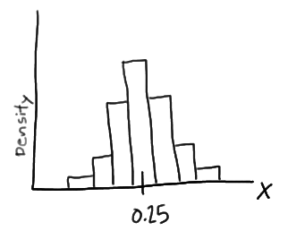
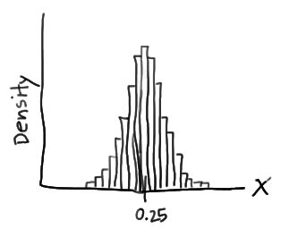
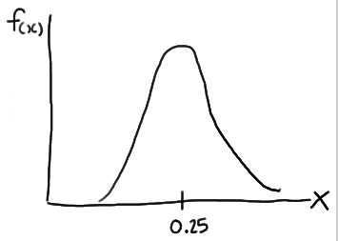
Probability Density Function
Distribution of 100 Hamburgers with an average weight of 0.25.
Decrease the interval of the histogram.
Decrease the interval of the histogram even more until it resembles a continuous distribution
https://onlinecourses.science.psu.edu/stat414/node/97/

Slide 19
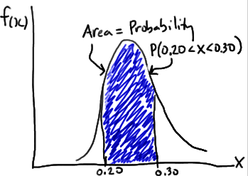



Probability Density Function
Probability Density Function:
Continuous random variable with support S is an integrable function f(x).
$$P(X ∈A)$$
$$\int_{−∞}^{∞}{f\left(x\right)dx}$$
$$\int_{0.20}^{0.30}{f\left(x\right)dx}$$
Probability Under the Curve that a hamburger weighs between 0.20 and 0.30 lbs.
Generalized
Specific
https://onlinecourses.science.psu.edu/stat414/node/97/

Slide 20
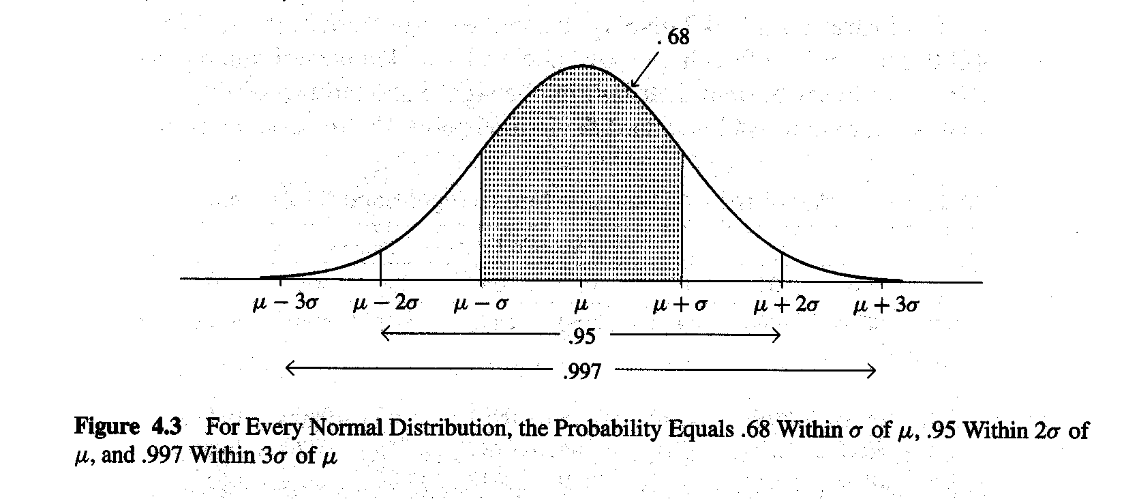
The Normal Probability Distribution
Attributes of normal distribution
Symmetric
Bell-shaped
Characterized by μ and σ
For all z, the probability concentrated within z standard deviations of the mean is the same

Slide 21

Z-Scores
The number of standard deviations away from the mean a given value of y is.
So a value of z=2 is 2 standard deviations above the mean
We can look up how likely it is for this value to be observed using tables of z-scores (http://www.z-table.com/) that correspond to various areas under the normal curve (values of the integral)
Z-Scores are also very useful if two variables are measured on different scales, and we wish to discuss them as if they area measured on the same scale.
E.g. Height in cm and income in dollars
$$z=\frac{y−μ}{σ}$$

Slide 22
Probabilities from the Normal Distribution
We may be interested in specific quantities from the normal distribution, and we want to know how likely they are.
For example, we have an observation that follows a standard normal distribution, what is the probability : Pr (y > 2)?
We can look up a Z-table (http://www.z-table.com/) and see for z = 2, the area under the curve is .9772, this is Pr (y<=2), so to find Pr (y>2) we do :
1-Pr (y<=2) = 1-.9772 = .0228, using our complement rule for probabilities, since the area under the curve is always 1

Slide 23

Probabilities from the Normal Distribution
What if we wanted to know Pr(a<= y <=b)? Well if we know a to be 1.2 and b to be 1.9, we can do it again by looking at our table.
To do this we need Pr (y<=1.9) and Pr (y<=1.2), and to find our Pr (1.2 <= y <=1.9), we subtract these
Pr (1.2 <= y <=1.9) =Pr (y<=1.9) - Pr (y<=1.2)
We look these values up in our table:
Pr (y<=1.9) = .9713, Pr (y<=1.2) = .8849, and
Pr (1.2 <= y <=1.9) = .9713 -.8849 = .0864
$$\operatorname{Pr}\left(a≤y≤b\right)=\int_{a}^{b}{f\left(y\right)dy}$$

Slide 24
Illustration: Women’s and Men’s Height in Inches
For adult females: μ=65.0, σ=3.5
For adult males: μ=70.0, σ=4.0
When z=1, probability is .68 that a randomly selected female will have a height ranging from:
μ-1σ = 65.0-3.5=61.5 to
μ+1σ = 65.0+3.5=68.5 inches
When z=3, probability is .99 that a randomly selected male will have a height ranging from:
μ-3σ = 70.0-3(4.0)=58.0 to
μ+3σ = 70.0+3(4.0)=82.0 inches
http://onlinestatbook.com/stat_sim/sampling_dist/index.html

Slide 25
Quantiles of the Normal distribution
We can calculate quantiles (percentiles) for the Normal distribution.
The pth percentile is just the value of x that we have observed p percent of the data by.
We can use these percentiles to assess if our data come from a normal distribution.
We compare the quantiles of our observed distribution to those of a Normal distribution with the same mean and standard deviation.
If our data come from a Normal distribution the quantiles should overlap and form a straight line

Slide 26
The Normal Quantile-Quantile (Q-Q) Plot
The Normal quantiles are represented by the straight line, and our data area the points.
This is another visual test where we examine the fit of the line to the data. If the data fit the Normal distribution we conclude they are normally distributed.
This is a visual test, and interpretation is very subjective.

Slide 27
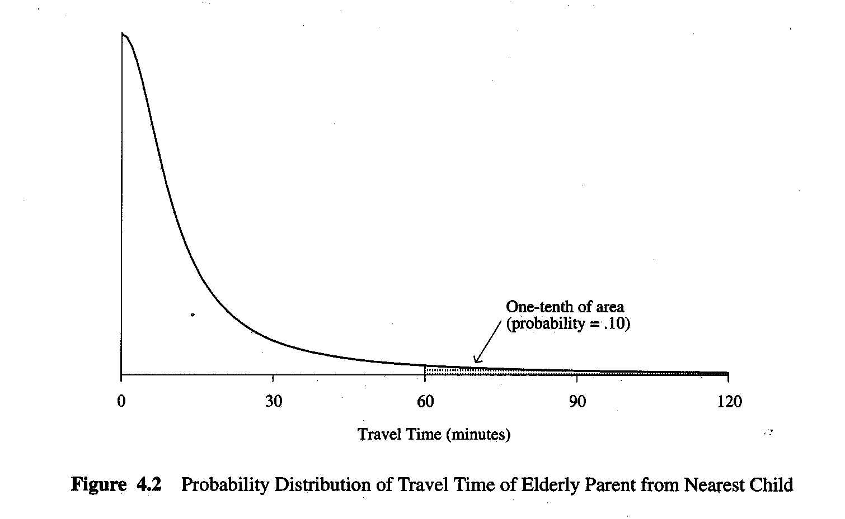
Probability Distribution for Continuous Variables
A continuum of possible values grouped into intervals
Time nearest child must travel to visit elderly parent

Slide 28
Closing Points
As a theoretical distribution, the sampling distribution need not be observed empirically
Sampling distribution is the core of inferential statistics
In practice, we do not know population mean (μ) and population standard deviation (σ)
Central limit theorem allows us make inferences about μ and σ without knowing them.

